Slide 1
BLUETOOTH DISCOVERY USING KALI LINUX
By: Howard Luis

Slide 2





What is Bluetooth?
Bluetooth is a short-range wireless networking protocol
Notes:
Bluetooth uses low power, low cost transmitters and receivers with a
range of 10-100 meters making it ideal for mobile use.
Bluetooth devices automatically detect and contact each other making communication between devices very easy

Slide 3

Why Bluetooth discovery?
I was inspired by an episode of “Mr. Robot”
Bluetooth is everywhere!
During the pentesting segment, we did not go over any bluetooth pen testing

Slide 4


Installing and Configuring Bluetooth Tools
Bluetooth comes in installed with Kali, but I read several posts that it wasn’t working properly.
Had to install, update, upgrade the OS.

Slide 5
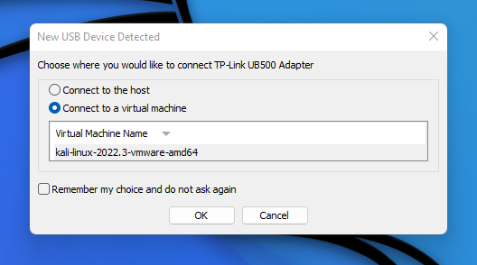

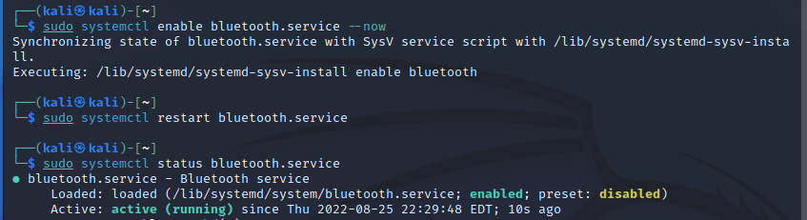
Installing and Configuring Bluetooth Tools Cont…
Since I was using a VM, I had to use a bluetooth scanner dongle I bought.
Bluetooth service is disabled and inactive on boot.

Slide 6





Installing and Configuring Bluetooth tools cont..
After further research, one of the tools, sdptool (service discover protocol) was not working properly due to compatibility issues:
Notes:
**** Will have to rerun this configuration again if bluez is updated.

Slide 7




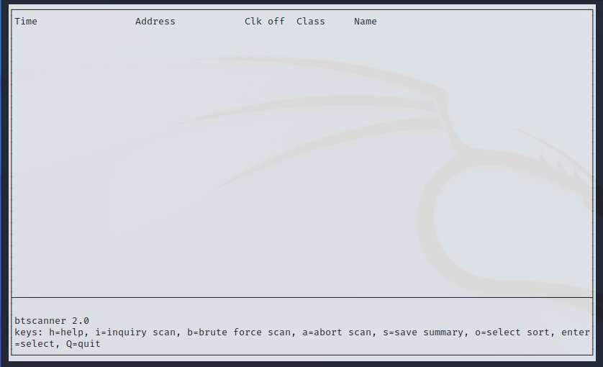


Tools used for bluetooth discovery

Slide 8
Bluetooth Discovery Demo

Slide 9


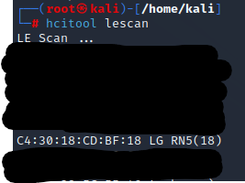
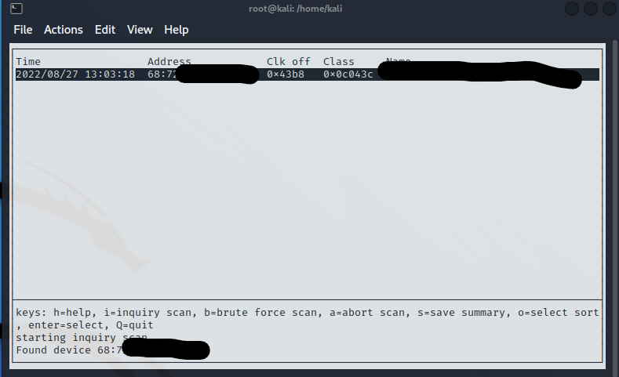

screenshots of results

Slide 10
Impact of bluetooth discovery
Finds target hosts
This step leads to vulnerability assessment then to the known bluetooth exploitations
Leads to attacks such as:
Bluesnarfing
Bluejacking
Bluetooth Impersionation Attacks (BIAS)
Bluebugging
Blueborne attack
Notes:
Bluesnarfing - network attacks, pairs with your bluetooth device without your knowledge and steals and comrpomises your personal data
Bluejacking - bluetooth device hijack with spam and advertising
Bluetooth Impersionation Attacks (BIAS) - attacker act as a man in the middle
Bluebugging - use bluetooth to establish a backdoor on a victim’s phone or laptop
Blueborne attack - Through BlueBorne, attackers can leverage Bluetooth connections to gain control over targeted devices.
victim's device does not even need to be set on discoverable mode for the attack to be a success
the hackers avoid all currently available security tools which protect only Internet connections.
no user interaction whatsoever is required to initiate the attack as is the case with most of the traditional malware attacks.
it could deploy malware on devices that are not connected to any other networks, even Internet.
it exposes Bluetooth devices to all kinds of cyber-attacks, including remote code execution and Man-in-the-Middle attacks.
BlueBorne can be used for ransomware attacks, cyber espionage, data theft, and even for including the infected mobile and IoT devices into large botnets.
malware distributed through BlueBorne would be highly infectious as it will immediately transfer to all adjacent devices that have Bluetooth connectivity.

Slide 11
Mitigation
Turn off bluetooth function when it is not needed
Turn off discovery mode on bluetooth
Don’t accept any file request transfers from unknown sources
When there are unknown pair requests, do not accept them

Slide 12
Research
null-byte.wonderhowto.com
unix.stackexchange.com
https://bbs.carchlinux.org

